Slide 1
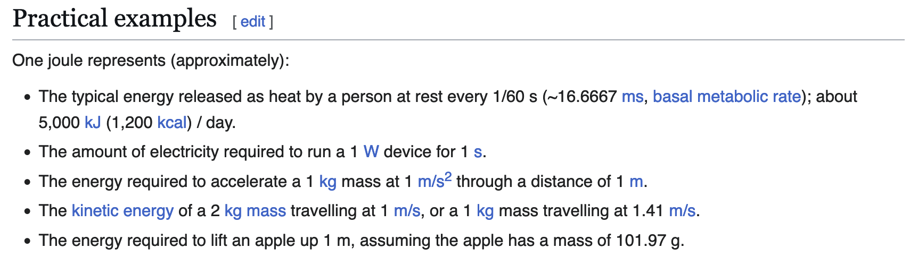
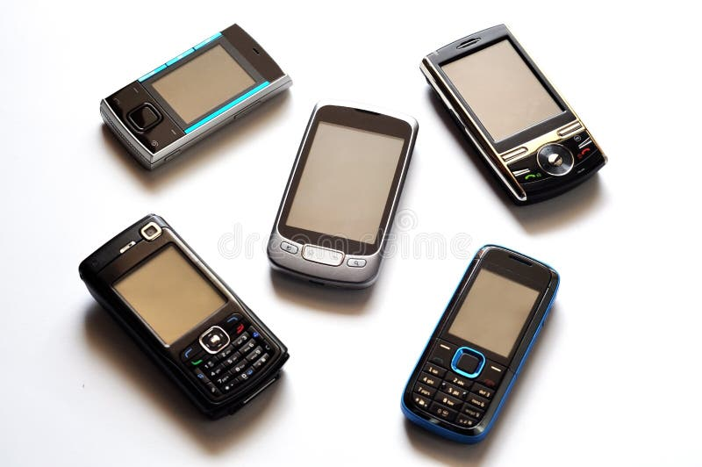
What’s a Joule?
Like a cell phone
https://en.wikipedia.org/wiki/Joule

Slide 2
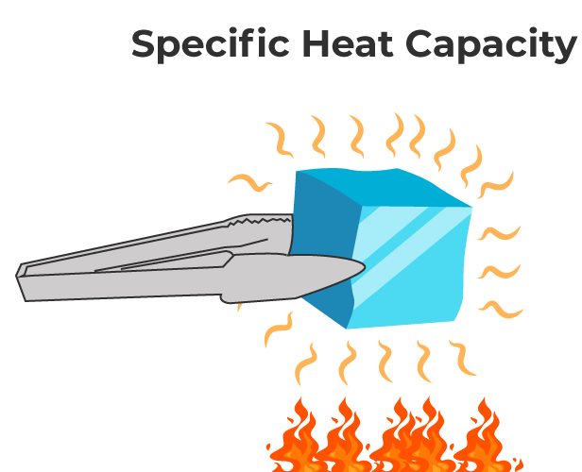
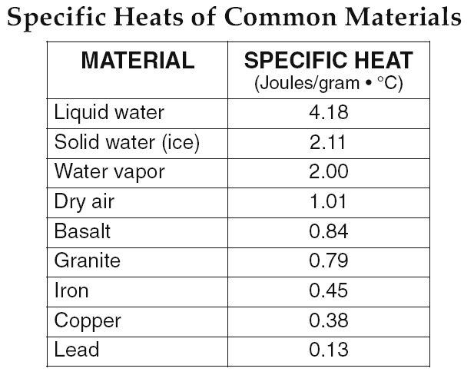
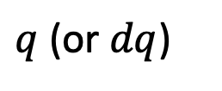
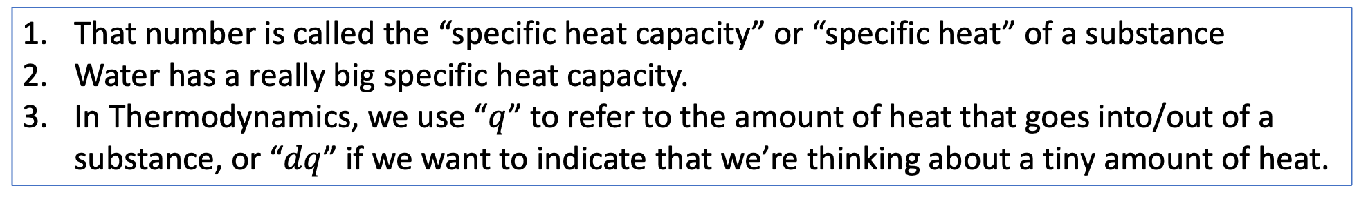
It takes 4.18 Joules to heat up one gram of liquid water one degree C
That number is called the “specific heat capacity” or “specific heat” of a substance
Water has a really big specific heat capacity.
In Thermodynamics, we use “$q$” to refer to the amount of heat that goes into/out of a substance, or “$dq$” if we want to indicate that we’re thinking about a tiny amount of heat.
$q$ (or $dq$)

Slide 3
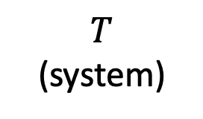

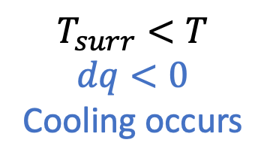
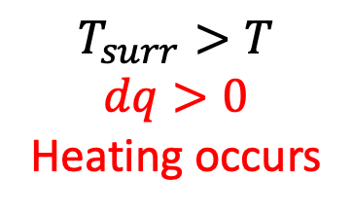
About that $q$ … we have to be talking about when the temperature of a substance is different from its surroundings, and there’s no insulating barrier between them
$$T_{surr}<T$$
$$dq<0$$
Cooling occurs
$$T_{surr}>T$$
$$dq>0$$
Heating occurs
$$T$$
(system)
If $T=T_{surr}$, “thermal equilibrium”

Slide 4
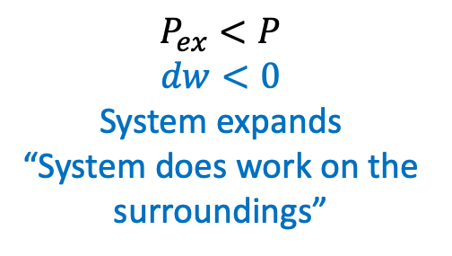
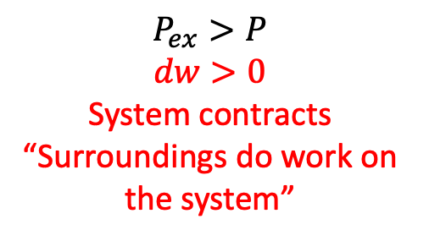
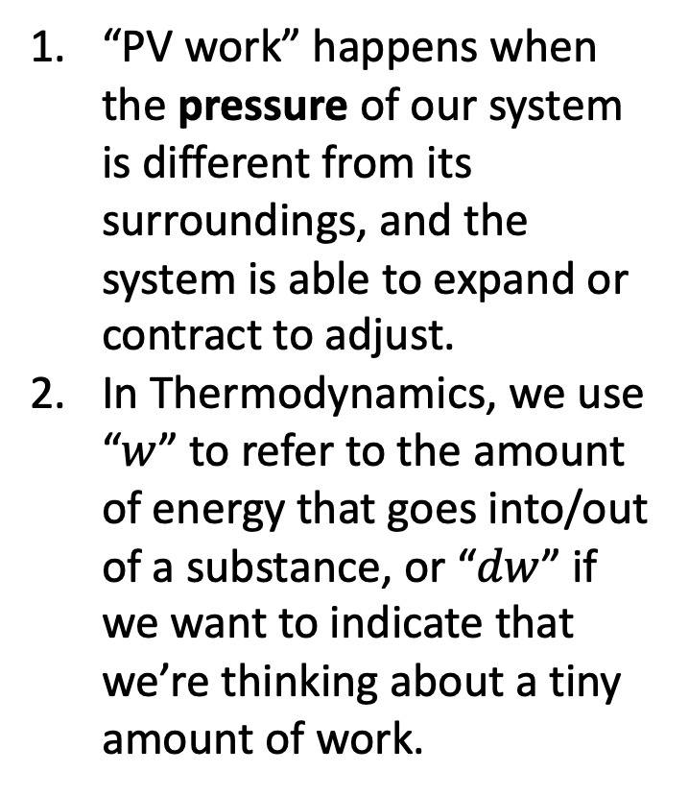


Thermodynamics calls it “work” when energy moves between a system and its surroundings as a result of anything other than a difference in temperature
“PV work” happens when the pressure of our system is different from its surroundings, and the system is able to expand or contract to adjust.
In Thermodynamics, we use “$w$” to refer to the amount of energy that goes into/out of a substance, or “$dw$” if we want to indicate that we’re thinking about a tiny amount of work.
$$P_{ex}<P$$
$$dw<0$$
System expands
“System does work on the surroundings”
$$P_{ex}>P$$
$$dw>0$$
System contracts
“Surroundings do work on the system”
$$P$$
(system)
$$P$$
(system)

Slide 5
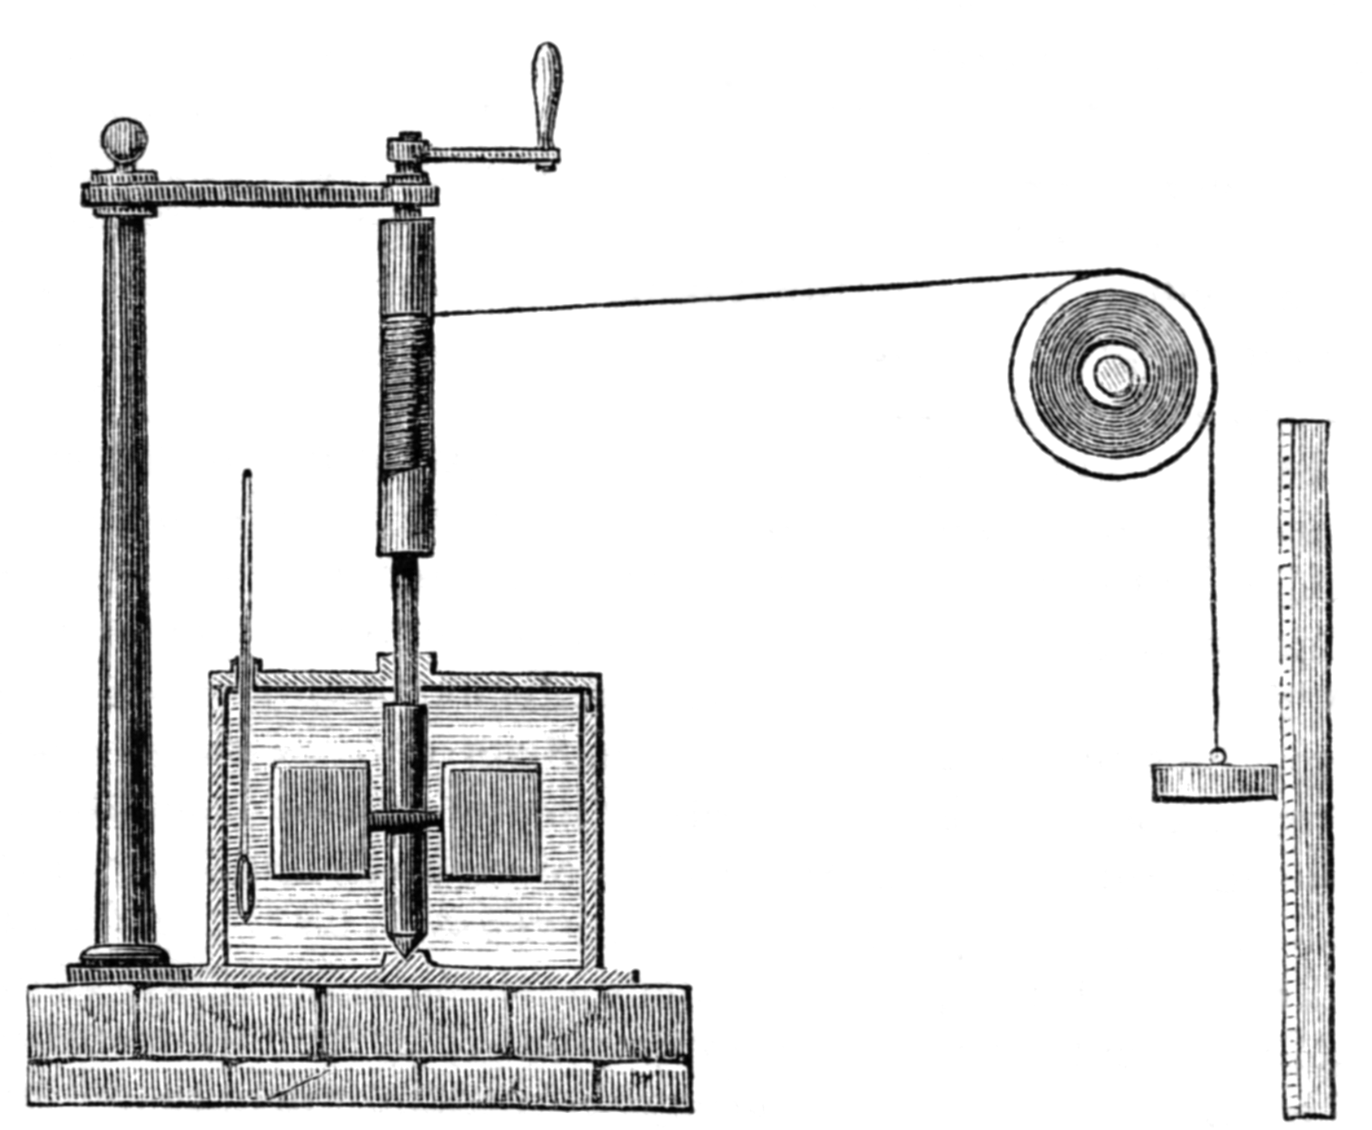
Other kinds of “work”: what happens when you stir, stretch, compress, or cause friction
In 1845, the English physicist James Joule wrote a paper On the mechanical equivalent of heat for the British Association meeting in Cambridge. In this paper, he reported his best-known experiment, in which the mechanical power released through the action of a "weight falling through a height" was used to turn a paddle-wheel in an insulated barrel of water.

Slide 6


1st law, infinitesimal form
$$dU=dq+dw$$
This is the same $U(T,V)$ that we’ve been talking about
If $dq+dw$ is positive, the energy of the system goes up
If $dq+dw$ is negative, the energy of the system goes down
If changes are large, we say $∆U=q+w$
$$U(T,V)$$
V
T

Slide 7
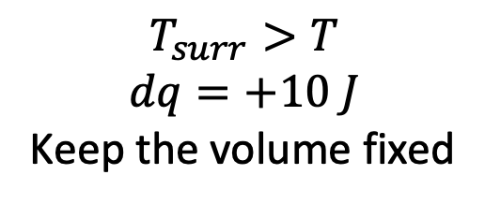
Applying the 1st law when heating (or cooling) a diatomic ideal gas
$$T_{surr}>T$$
$$dq=+10 J$$
Keep the volume fixed
$$U(T,V)$$
V
This looks like isochoric heating
T
T
(system)

Slide 8
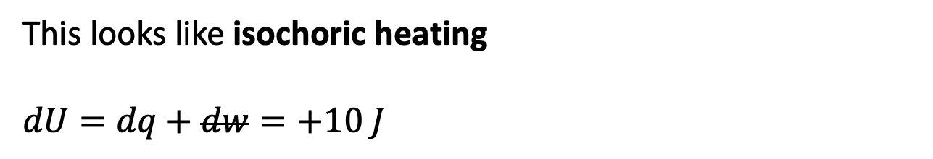
Applying the 1st law when heating (or cooling) a diatomic ideal gas
$$T_{surr}>T$$
$$dq=+10 J$$
Keep the volume fixed
$$U(T,V)$$
V
This looks like isochoric heating
$$dU=dq+dw=+10 J$$
T
T
(system)

Slide 9
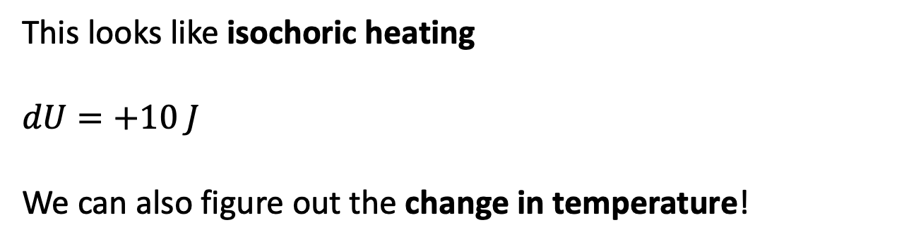
Applying the 1st law when heating (or cooling) a diatomic ideal gas
$$T_{surr}>T$$
$$dq=+10 J$$
Keep the volume fixed
$$U(T,V)$$
V
This looks like isochoric heating
$$dU=+10 J$$
We can also figure out the change in temperature!
T
T
(system)

Slide 10
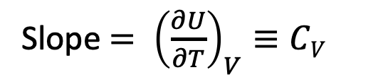

Finding dU from dT and dV, for a single step
“Slope equals rise/run”
$$U(T,V)$$
Slope $= {\left(\frac{∂U}{∂T}\right)}_{V}≡CV$
V
T
dT

Slide 11
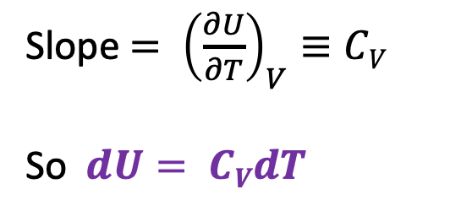
Finding dU from dT and dV, for a single step
$$U(T,V)$$
Slope $= {\left(\frac{∂U}{∂T}\right)}_{V}≡CV$
So $dU= CVdT$
V
T
dT
“Rise equals slope x run”

Slide 12
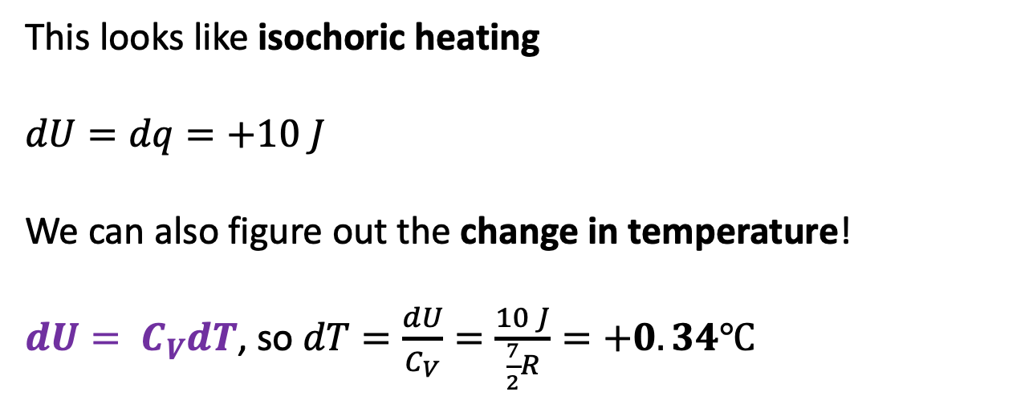

Applying the 1st law when heating (or cooling) a diatomic ideal gas
$$T_{surr}>T$$
$$dq=+10 J$$
Keep the volume fixed
$$U(T,V)$$
V
This looks like isochoric heating
$$dU=dq=+10 J$$
We can also figure out the change in temperature!
$dU= C_{V}dT$, so $dT=\frac{dU}{C_{V}}=\frac{10 J}{\frac{7}{2}R}=+0.34℃$
T
T
(system)
($C_{V}$ in the classical limit)

Slide 13

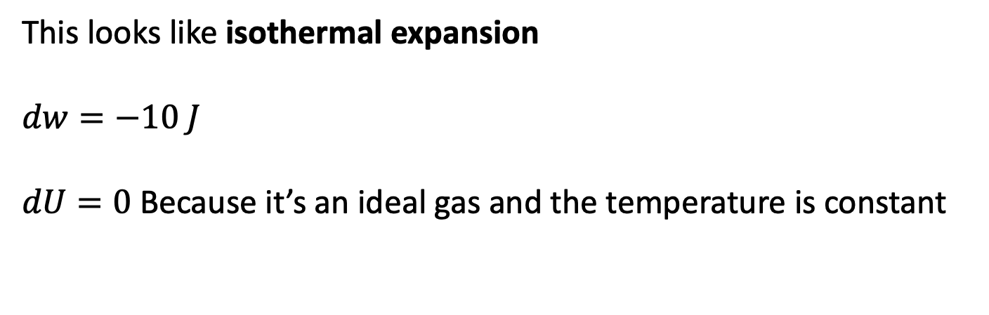
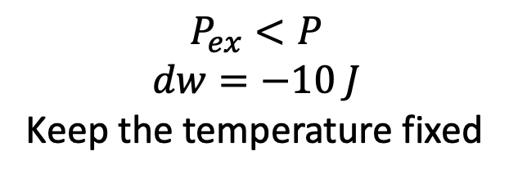
Applying the 1st law when expanding (or contracting) a diatomic ideal gas
$$P_{ex}<P$$
$$dw=−10 J$$
Keep the temperature fixed
$$U(T,V)$$
V
This looks like isothermal expansion
$$dw=−10 J$$
$dU=0$ Because it’s an ideal gas and the temperature is constant
T
$$P$$
(system)

Slide 14
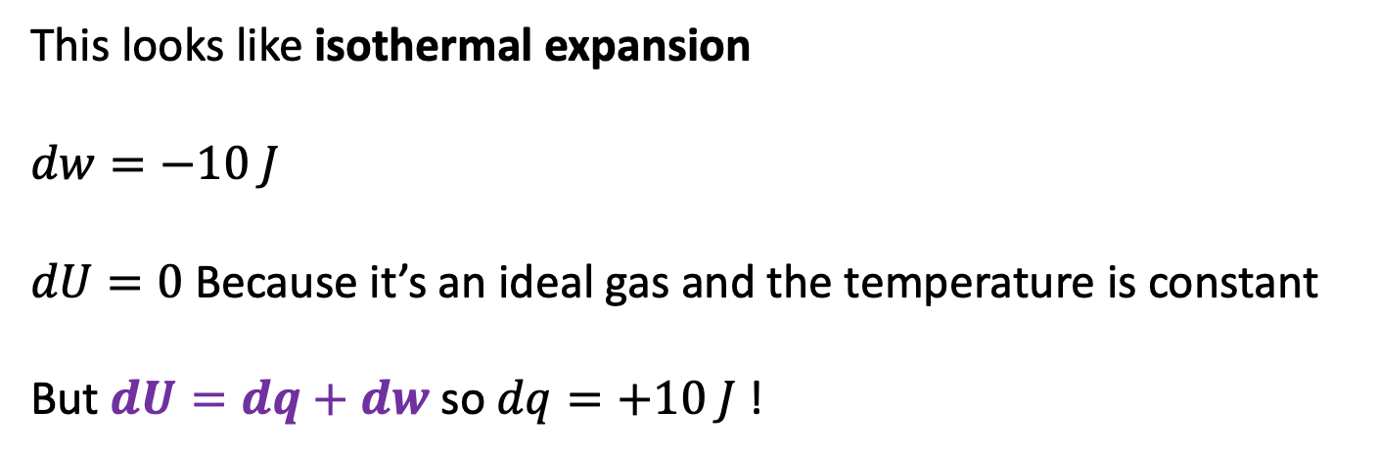
Applying the 1st law when expanding (or contracting) a diatomic ideal gas
$$P_{ex}<P$$
$$dw=−10 J$$
Keep the temperature fixed
$$U(T,V)$$
V
This looks like isothermal expansion
$$dw=−10 J$$
$dU=0$ Because it’s an ideal gas and the temperature is constant
But $dU=dq+dw$ so $dq=+10 J$ !
T
$$P$$
(system)

Slide 15
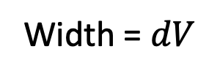

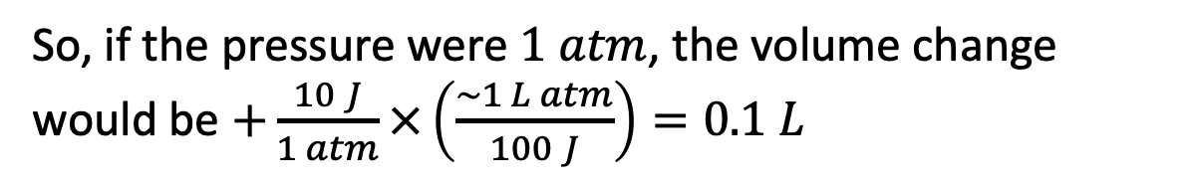
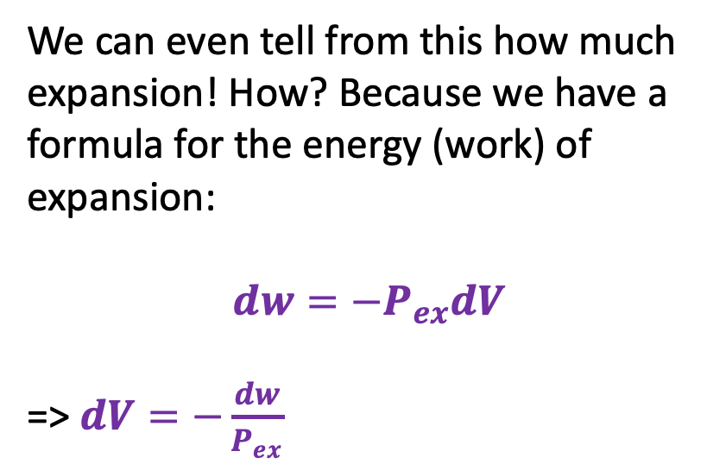


Relating PV work, single step, to the change in volume
$$P_{ex}<P$$
$$dw=−10 J$$
Keep the temperature fixed
$$U(T,V)$$
We can even tell from this how much expansion! How? Because we have a formula for the energy (work) of expansion:
$$dw=−P_{ex}dV$$
=> $dV=−\frac{dw}{P_{ex}}$
V
T
$$P$$
(system)
$$P_{ex}$$
$$P_{Ideal}=nRT/V$$
So, if the pressure were $1 atm$, the volume change would be $+\frac{10 J}{1 atm}×\left(\frac{\sim 1 L atm}{100 J}\right)=0.1 L$
Width = $dV$
$$V$$

Slide 16
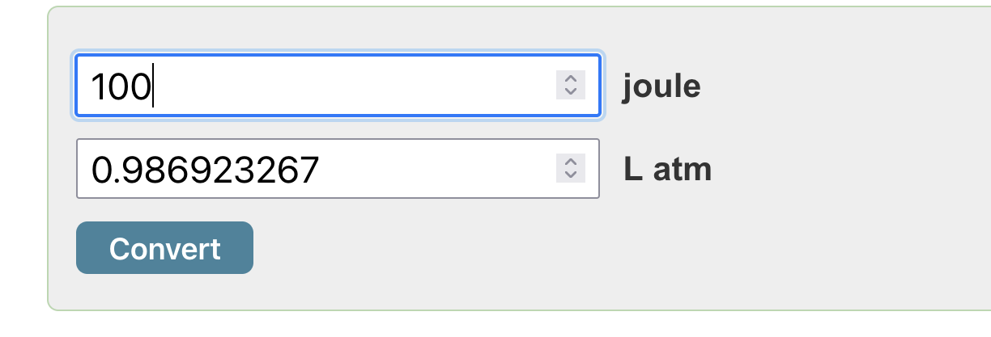
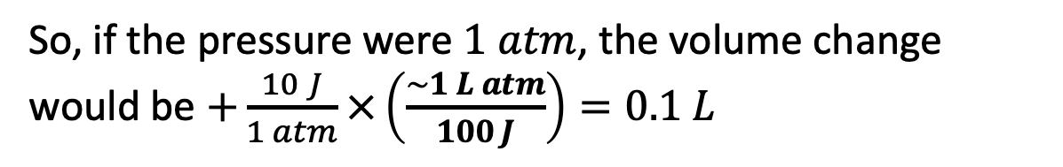
Conversions … good to know that $1 L atm$ equals about $100 J$ … but the exact conversion is
https://www.convertunits.com/
However, we’ll be doing most of our work with the help of Pint
So, if the pressure were $1 atm$, the volume change would be $+\frac{10 J}{1 atm}×\left(\frac{\sim 1 L atm}{100 J}\right)=0.1 L$

Slide 17









Multistep isothermal expansion/contraction of an ideal gas
Each step does $dw=−P_{ex}dV$ work
After each step let a little heat in to keep $T$constant
Drop $P_{ex}$ a bit so the system expands a little more
$$P_{ex}$$
$$P_{ex}$$
$$P_{2},V_{2}$$
$$P_{1},V_{1}$$
$$P_{ex}$$
$$P_{Ideal}=nRT/V$$
$$V_{1}$$
$$V_{2}$$

Slide 18
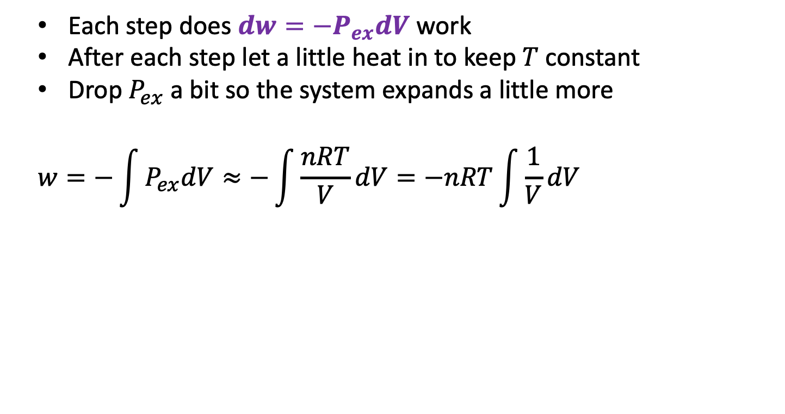
Multistep isothermal expansion/contraction of an ideal gas
Each step does $dw=−P_{ex}dV$ work
After each step let a little heat in to keep $T$constant
Drop $P_{ex}$ a bit so the system expands a little more
$$w=−\int{P_{ex}dV≈−\int{\frac{nRT}{V}dV}=−nRT\int{\frac{1}{V}dV}}$$
$$P_{ex}$$
$$P_{ex}$$
$$P_{2},V_{2}$$
$$P_{1},V_{1}$$
$$P_{ex}$$
$$P_{Ideal}=nRT/V$$
$$V_{1}$$
$$V_{2}$$

Slide 19






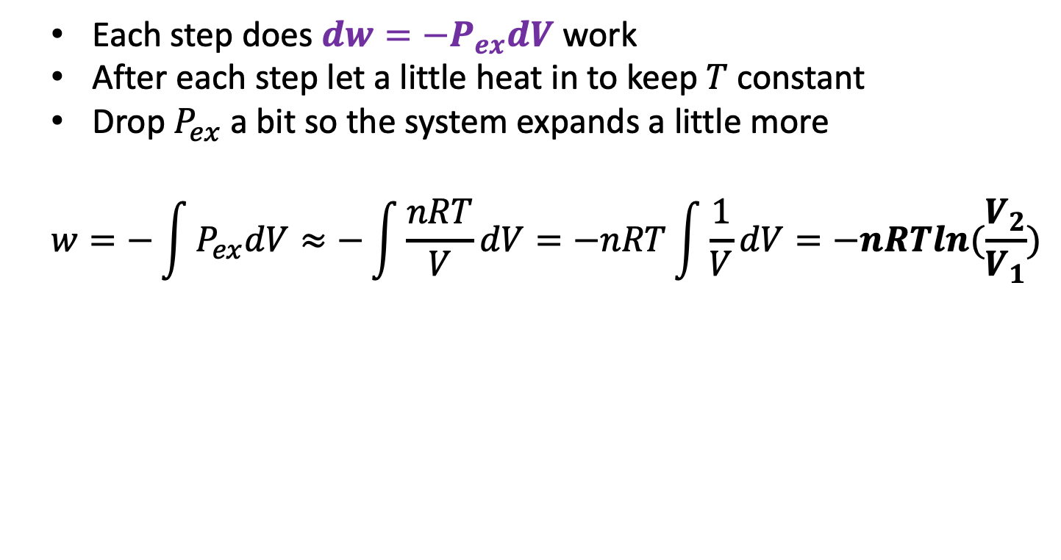


Multistep isothermal expansion/contraction of an ideal gas
Each step does $dw=−P_{ex}dV$ work
After each step let a little heat in to keep $T$constant
Drop $P_{ex}$ a bit so the system expands a little more
$$w=−\int{P_{ex}dV≈−\int{\frac{nRT}{V}dV}=−nRT\int{\frac{1}{V}dV}=−nRTln(\frac{V_{2}}{V_{1}})}$$
$$P_{ex}$$
$$P_{ex}$$
$$P_{2},V_{2}$$
$$P_{1},V_{1}$$
$$P_{ex}$$
$$P_{Ideal}=nRT/V$$
$$V_{1}$$
$$V_{2}$$

Slide 20
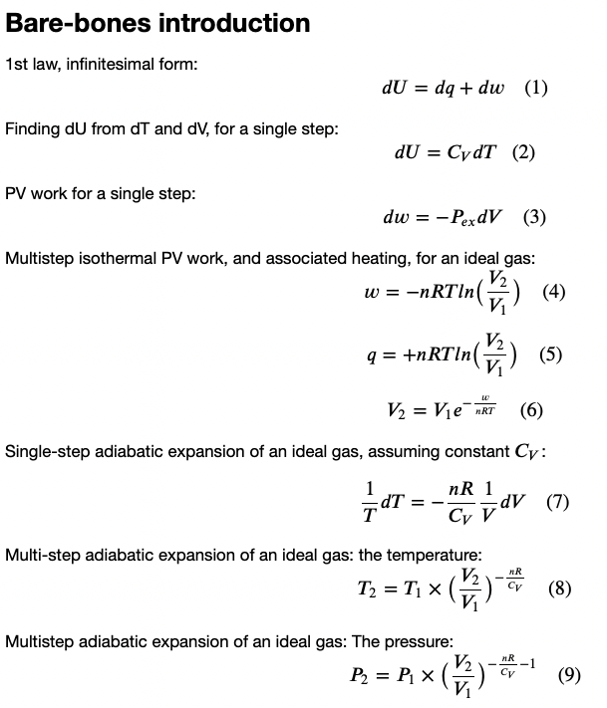
Where we are so far

